Slide 1
Nagios Installation & Configuration
DevOps 2019

Slide 2

Agenda
How to install Nagios
Launch the Nagios
Understand different terms in Nagios
Walk through GUI & Understand the different Configs
Monitor multiple services, hosts & networks With Nagios

Slide 3
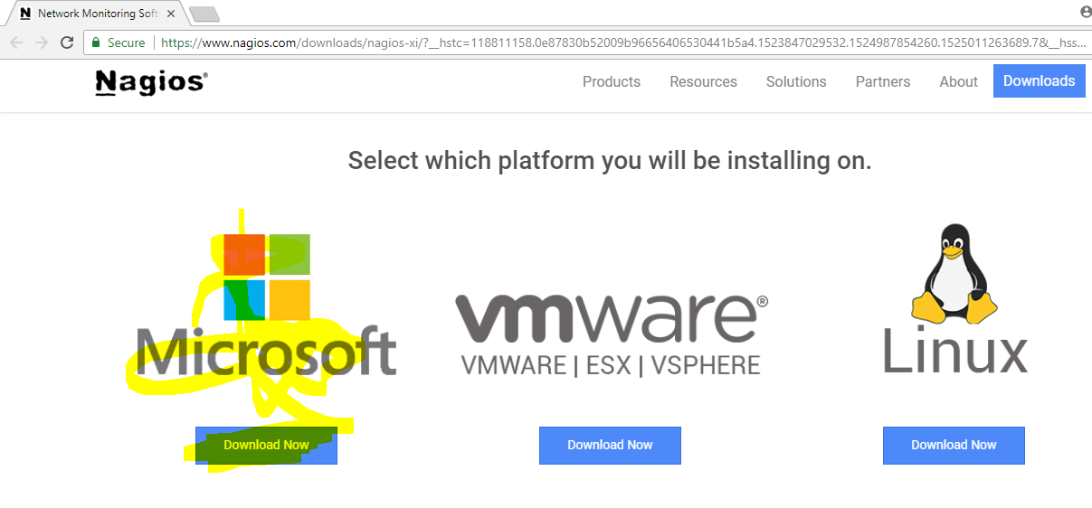
Nagios Installation
Goto → https://www.nagios.org/downloads/
Download Nagios XI to run on windows VM Player

Slide 4
Nagios Installation
download a .ova file which we can run with any virtualization software such as vm-player or virtual box etc….
Ensure vm player or virtual box is installed on your windows box. You can download the same from below link
https://my.vmware.com/en/web/vmware/free#desktop_end_user_computing/vmware_works tation_player/12_0

Slide 5
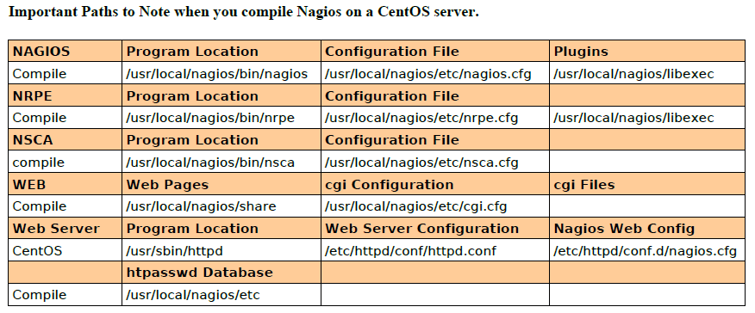

Slide 6
Definitions
Active Check
A check that is initiated and performed by Nagios XI on a check interval which you define. Active checks can be agent-based, or agent less using native protocols such as SNMP or WMI.
Agent
Software that is installed on a host to enable Nagios XI to execute plug ins on the host to check granular metrics (known as ‘services’ in Nagios). Agents are available for a wide variety of operating systems.
Alert
An alert is generated when a problem is found. When XI detects a problem state, it can send an email, send a text, send an SNMP trap upstream, or execute a custom script.
Apply Config
Each time configuration changes are made via a wizard, or in the Core Config Manager (CCM), it is necessary to Apply Config. This promts Nagios XI to do a sanity check of the new configs, and either write them if they are functional, or produce an error if a problem is found with the new configs.

Slide 7
Auto-Discovery Wizard
Nagios XI has a built-in Auto-Discovery wizard. When running an Auto-Discovery job the user will enter a subnet they would like to scan and a job is created, which utilizes fping and nmap to scan the network defined for alive machines and then performs an nmap scan on the host to determine which ports it is listening on. The results of the Auto-Discovery scan additionally report the OS of the machine discovered as well as all of the ports the host is listening on. A user can then optionally pass these results into a wizard that will monitor to make sure all of these ports continue to be responsive.
Config Snapshots
Configuration Snapshots are taken each time you Apply Configuration, and can be found in the Admin -> Config Snapshots menu. The most recent 10 applied configs will be shown here, and these snapshots can be archived, downloaded, and restored from easily. Note that if an apply config attemp fails, you can review the output in this menu and remediate, or roll back to a previous good config and attempt your changes again. In the meantime, XI will continue to monitor using the last successfully applied configuration.
Config Wizards
Configuration wizards guide users through the process of monitoring new devices, services, and applications – all without having to understand complex monitoring concepts. You can download additional Config Wizards at the Nagios Exchange

Slide 8
Dashboard
A customizable page on which dash lets can be placed. Nagios XI offers each user the ability to have multiple dashboards for customized views of important data. Dashboards can also be shared with other users by admins
Dash let
A customizable container that can be placed on a custom dashboard. Examples of different dash lets include performance graphs, group status summaries, maps, custom URLS, and other data
Host
A host is anything with an IP, URL, or FQDN, such as a physical server, a VM host or guest, a router, or a webpage.
Host Group
Host groups enable you to logically group sets of hosts for display, configuration, and reporting purposes.
Notification
A notification is an email or text that is sent when state changes are detected on monitored objects.

Slide 9
Nagios Exchange
Nagios Exchange is the central place where you’ll find all types of Nagios projects - plugins, addons, documentation, extensions, and more. Nagios Exchange is designed for the Nagios Community to share its Nagios creations. Have a new project for Nagios that you’d like to share? Just create an account and add it to the directory at http://exchange.nagios.org
Nagios Knowledgebase
The Nagios Knowledg base is a centralized collection of hundreds of articles, tutorials, and documentation links to help you configure and use the entire suite of Nagios solutions at http://support.nagios.com/kb
NCPA
NCPA is the Nagios Cross Platform Agent. This agent works on Linux, Windows, OSX, and AIX, and supports both active and passive monitoring. NCPA includes a web GUI, real-time server data graphing, and an advanced check API.
Report
Nagios XI includes a variety of reports which enable you to review the historical performance of your monitored objects. Reports can be customized to focus on specific time periods, hosts, and groups, and also support negating things like scheduled downtime and unreachable states. Reports can be exported, emailed, and (in the Enterprise edition of XI) scheduled for automatic delivery.

Slide 10
Passive Check
A check that is performed by an external application, operating system, or device and is submitted to Nagios Core or Nagios XI for processing. Some monitoring agents - including NSCA, NCPA, and NRDP can be used to send passive checks to Nagios. An SNMP trap is also
considered a passive check.
Plug-ins
Plug-ins allow you to monitor just about anything and everything with Nagios - databases, operating systems, applications, network equipment, protocols and more. A variety of plug-ins are available in Nagios XI by default, and thousands more can be found on the Nagios Exchange. It is also possible to write your own custom plug-ins using the Nagios Plug-in Development Guidelines.
Service
A granular metric being monitored on a host, such as CPU and memory usage, drivespace, interface bandwidth, or the status of a system service or process.
Service group
Service groups enable you to logically group sets of services for display and reporting purposes.
SNMP/SNMP Trap
Simple Network Management Protocol (SNMP) is a native protocol available on a variety of operating systems and devices which enables monitoring of specific metrics. SNMP can be checked actively by Nagios, or data can be sent passively to Nagios from the device using SNMP Traps.

Slide 12


